Slide 1
Beyond Warnings: Using Humour to Talk About AI Use
UWTL2026 | Day 1 | Online Conference | April 29
"The Human Factor: Shaping the Role of AI in Higher Education"
Elan Paulson, PhD, University of Guelph, paulsone@uoguelph.ca
This work is licensed under the Creative Commons Attribution-NonCommercial-ShareAlike 4.0 International License.
Notes:
https://teachingascraft.blog/2026/04/24/937/
https://nmdprojects.net/learnwithai_www/impactrisk/

Slide 2
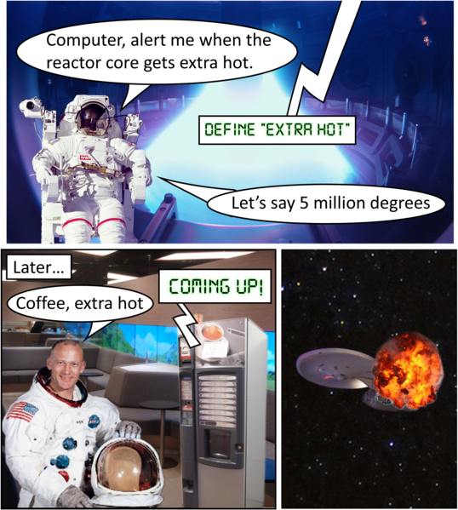
ikael Häggström, M.D. Author info - Reusing images- using source images by various creators (see above), CC BY 4.0, via Wikimedia Commons
Description): A three-panel comic strip. In the first panel an astronaut in his suit and helmet says, "Computer, alert me when the reactor core gets extra hot." An AI computer voice says, "Define extra hot." The astronaut replies, "Let's say 5 millon degrees."
In the second panel, titled "Later...," the white male astronaut inside the spaceship with his helmet off says, "Coffee, extra hot." The computer, which is a coffee vending machine, says, "Coming up!"
In the third panel, a picture of a ship in space is exploding.

Slide 3

How Anonymity and Assumptions About Other Shift Our Behaviours
Social Loafing: Individuals exert less effort when they feel their personal lack of effort will go unnoticed (anonymity), especially in groups where individuals feel a diffusion of responsibility
“The AI Cheating Vibe Shift” (Chronicle of HE, 2025)
"Social Lofting" by EDCU320RHT / CC BY-SA 4.0

Slide 4
Message Framing and Behaviour Change
For disengaged audiences, emotional framing outperforms rational argument (Hoover et al., 2018)
The brain processes short-term and long-term consequences through competing systems (Bradt, 2004)
After repeated exposure to fear-based messaging, humour shows advantages for engagement and behavioural intention (Skurka et al., 2018)
Humorous messages increase attention, improve retention, and build rapport (Zhou & Lee, 2025)

Slide 5
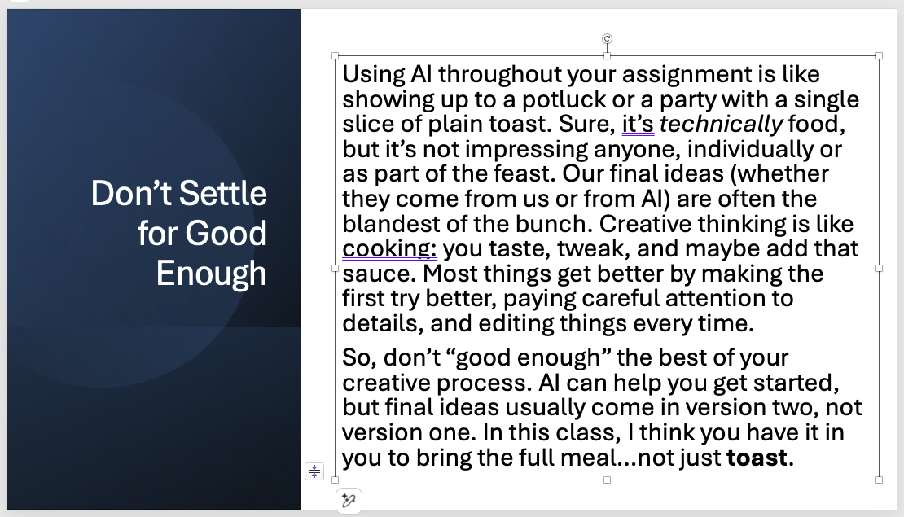
90-minute self-paced faculty "workshop" outline and activities
1. Welcome (instruction, timing)
2. Why humour matters (3 types, social commentary and learning with humour videos)
3. Interpret AI cartoons (review then discuss)
4. Learning about AI with humour (Examples, Menti poll comparing messaging frames)
5. Review AI class messages (listen then discuss)
6. Wrap-up (creative commons downloads)
Image 3: A screenshot of a positive message example from the self-paced workshop. AI Is Funny Slides are CC0.

Slide 6
Selected Videos on AI Education with a Humourous Frame and/or a Positive Message
Video | Short Summary
Thurston, B. (2024, October 2). Double Check Your AI Writing Outputs. Bloomreach. | Emmy-nominated speaker Baratunde Thurston shares a personal story about using AI to generate content and discovering that AI gives users what it wants, not what is true.
Minecraft Education. (2024, September 3). Introducing AI: Building the Basics. YouTube. | Part of the AI Adventurers series, this animated video demystifies AI and explains how it works using a chicken and a knight as unlikely pals.
Minecraft Education. (2024, September 3). AI in Action: Using AI Tools Responsibly. YouTube. | Part of the AI Adventurers series, this animated video teaches students how to use AI tools safely and responsibly, including choosing the right tool for the task and giving detailed instructions.
Minecraft Education. (2025, April 8). AI Skills Fest: Build AI Skills with Minecraft. YouTube. | A compilation video from the AI Adventurers series. The segment beginning at 5:45 explores how AI appears in everyday life and emerging applications such as chatbots.
Common Sense Education. (n.d.). Artificial Intelligence: Videos for Students and Teachers. YouTube. | A playlist of seven short, accessible videos explaining AI concepts with a friendly tone, including "What is AI?", "What are AI Chatbots?", and "What is ChatGPT?"
Association for the Advancement of Artificial Intelligence. (n.d.). AAAI Educational AI Videos. AAAI. | A curated collection of short, informative videos that often use humor and creativity to explain AI topics. The AAAI competition specifically encourages submissions with "entertainment, creativity, and/or humor."

Slide 7

3 Implications and (Lots of) Takeaways for Practice
Warning-only framing can position educators as enforcers and students as potential offenders
Positive partnership framing may be more likely to reach students during independent decision-making moments
Humorous messaging should complement clear policy and serious consequences --> not replace them
Presentation Takeaway Toolkit:
Downloadable CC media with comics and positive messages
Links to podcasts
An outline of the AI Humour workshop
A copy of these slides
Notes:
https://teachingascraft.blog/2026/04/24/937/

Slide 8
References and More Resources
More Resources on Humour and Humour for Engagement and Learning
Presentation References
Bradt, S. (2004, October 14). Brain takes itself on over immediate vs. delayed gratification. The Harvard Gazette.
Glass, I. (Host). (2025, February 7). Ira Glass teaches you how to make money [Audio podcast episode]. This American Life Partners. Apple Podcasts.
Hoover D.S., Wetter D.W., Vidrine D.J., Nguyen N., Frank S.G., Li Y., Waters A.J., Meade C.D., Vidrine J.I. (2018). Enhancing Smoking Risk Communications: The Influence of Health Literacy and Message Content. Annals of Behavioral Medicine, 17, 52(3):204-215. doi: 10.1093/abm/kax042. PMID: 29538662; PMCID: PMC5942894.
Skurka, C., Niederdeppe, J., Romero-Canyas, R., & Acup, D. (2018). Pathways of influence in emotional appeals: Benefits and tradeoffs of using fear or humor to promote climate change-related intentions and risk perceptions. Journal of Communication, 68(1), 169-193. https://doi.org/10.1093/joc/jqx008
Stripling, J. (Host). (2025, January 21). The cheating vibe shift [Audio podcast episode]. In College matters from The Chronicle. The Chronicle of Higher Education.
Zhou, W., & Lee, J. C. (2025). Teaching and learning with instructional humor: A review of five-decades research and further direction. Frontiers in Psychology, 16, Article 1445362. https://doi.org/10.3389/fpsyg.2025.1445362
Brown. J.A. (2024, October 8). Gen Z: Humor as a social commentary tool [Video]. YouTube. https://youtube.com/watch?v=_9ZSxohvcoY
Croon, J. (2019, November 1). Your brain loves learning through laughter [Video]. YouTube. https://youtube.com/watch?v=4E9sScCXZuE
Morreall, J. (2009). Humor as cognitive play. In Theories of Humor (pp. 45-67). Cambridge University Press.
Lintott, S. (2016). Superiority and Humor. In Philosophy of Humor (pp. 89-102). Routledge.
Nijholt, A. (2020). All the world's a stage: incongruity humour revisited. Humor in Human-Computer Interaction. Springer.
Notes:
This work is licensed under the Creative Commons Attribution-NonCommercial-ShareAlike 4.0 International License.
Microsoft 365 Copilot was used to format the references and provide feedback on alignment between slide content and presentation notes

