Slide 1
AI Jokes and Cartoons – Is it Funny? And Why?
Elan Paulson, PhD
Teaching Innovation Consultant
Teaching and Learning
Note: All images are sourced from the internet and are creative commons-licensed or have received the creators' approval to share. If you wish to use any of these images, please provide attributions to the authors accordingly.
Notes:
Join this one-hour workshop to reflect on the "serious humour" about AI in open source illustrations and cartoons available on the internet. Consider how you might use an image to open the conversation with students about AI.

Slide 2
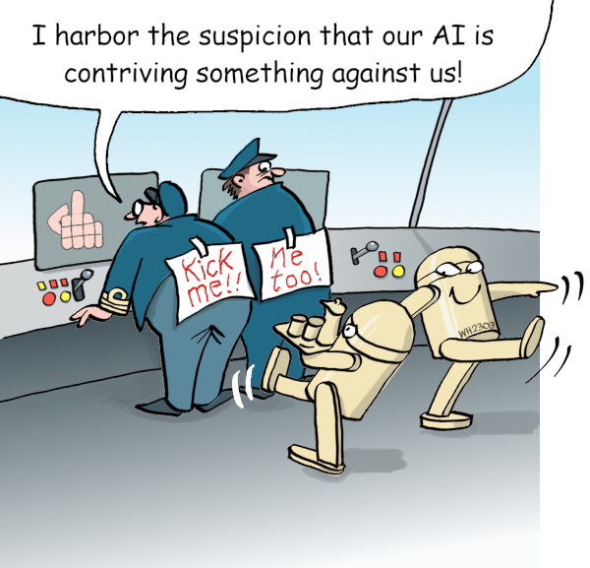
Kick Me-E by Werner Huth, CC0, via Wikimedia Commons
One robot is carrying drinks on a tray and moving towards to white male pilots in charge of a dashboard. A second robot is walking away empty-handed but with a smile on his face. The pilots have signs on their backs "kick me" and "me too" and the screen is using an offensive finger gesture.
One person says, "I harbor the suspicion that our AI is contriving something against us!”
NOTE: There is a hand gesture in this cartoon some might find offensive.

Slide 3
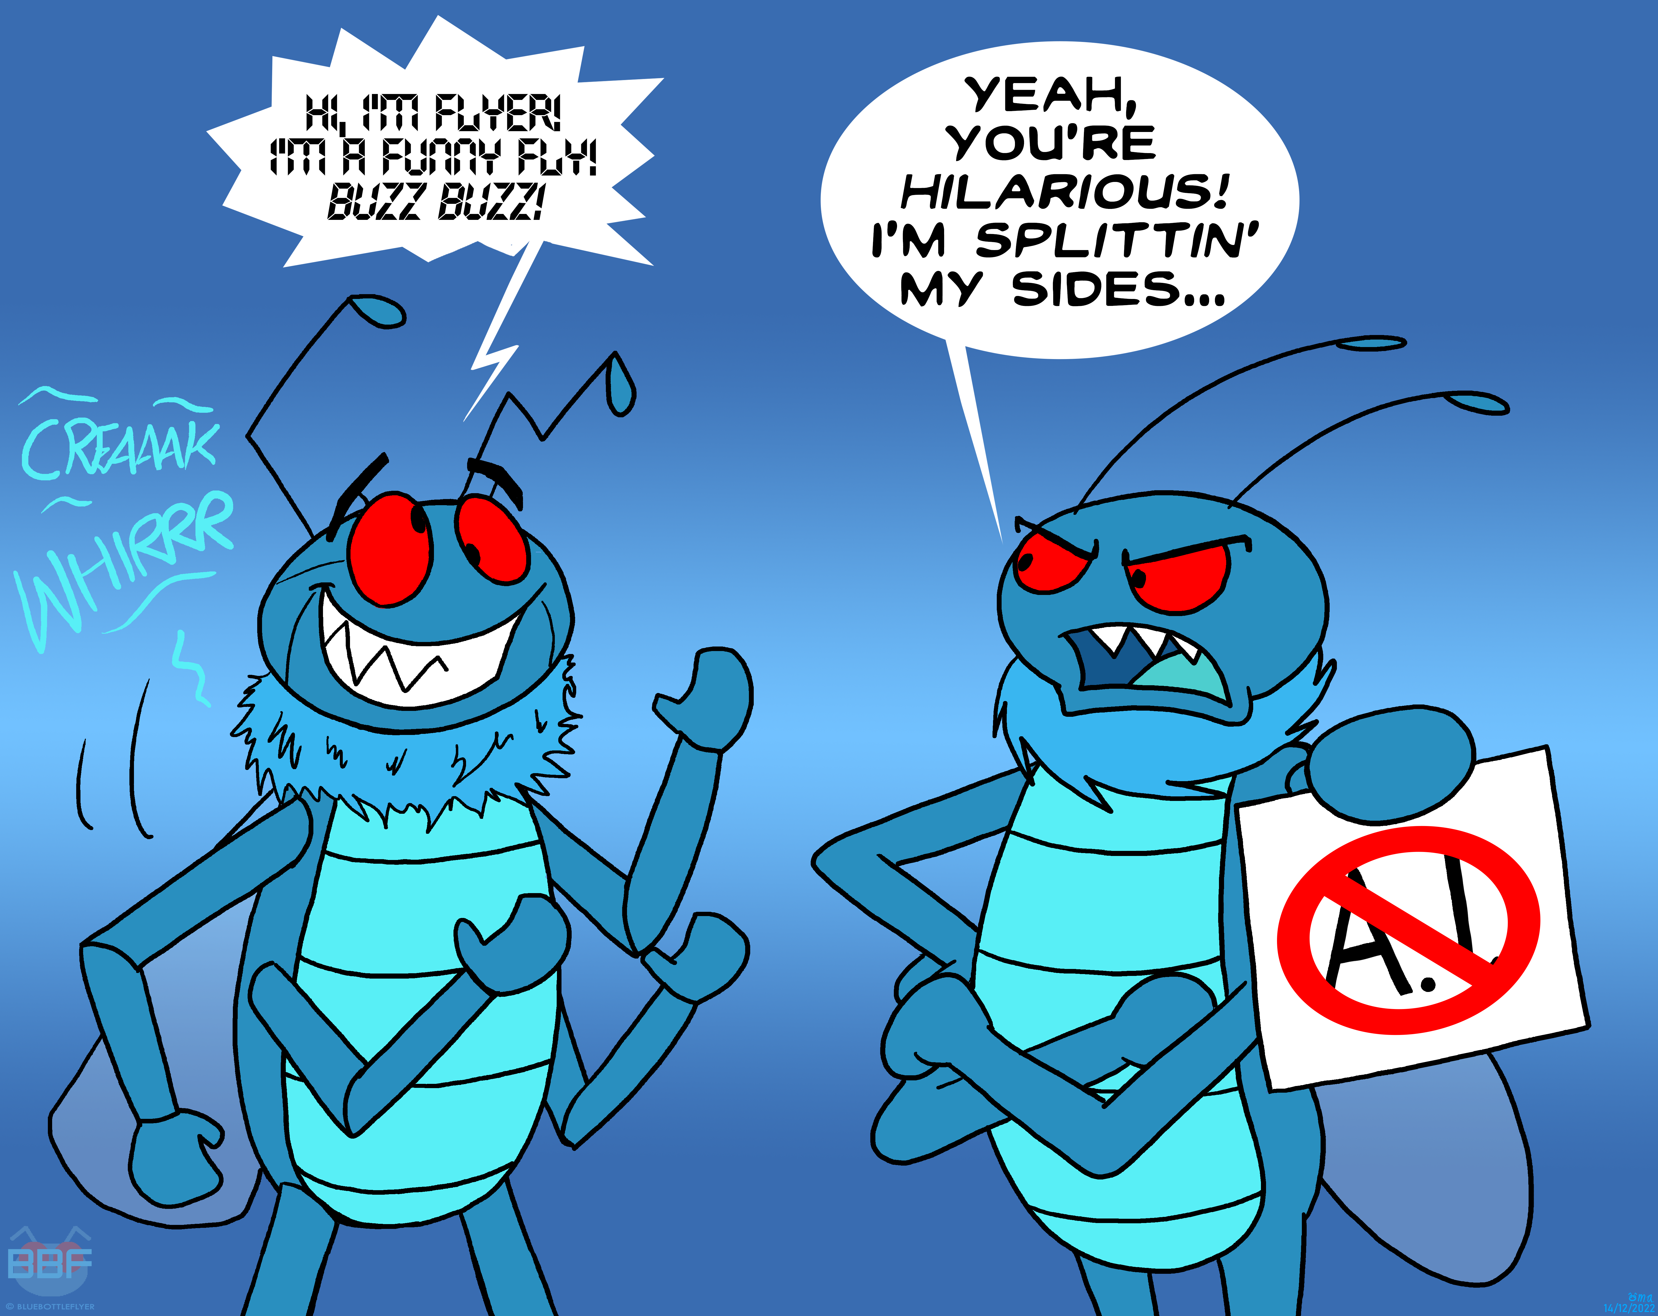
AI Don't Fly by BluebottleFlyer is CC BY-ND 3.0
A mechanical looking and sounding bluebottle fly says, "Hi. 'Im flyer. I'm a funny fly. Buzz buzz." A second fly holding a no-AI sign looks critically at the first fly and says, "Yeah you're hilarious. I'm splitting my sides."
The author's caption says: My two pennies on this subject...you wouldn't replace Flyer with a robot - same should go for us human artists. #noaiart

Slide 4
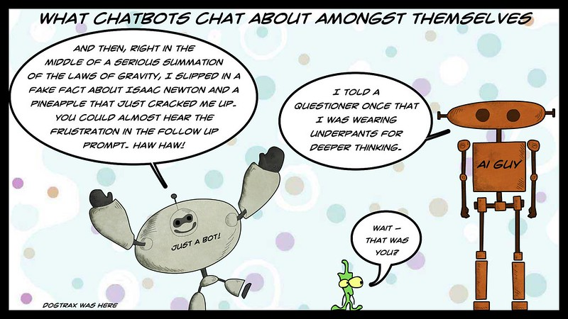
It's Only AI 3 (Bragging Bots) by Dogtrax (Kevin Hodgson) is CC BY-SA 2.0
The title says "What Chatbots Chat About Amongst Themselves."
One chatbot named Just A Bot says while smiling and holding up his hands, "And then, right in the middle of a serious summation of the laws of gravity, I slipped in a fake fact about Isaac Newton and a pineapple that just cracked me up. You could almost hear the frustration in the follow up prompt. Haw haw."
A second chatbot named AI guy says, with no expression, "I told a questioner once that I was wearing underpants for deeper thinking."
A little green creature looks at AI guy and says, "Wait, that was you?"

Slide 5
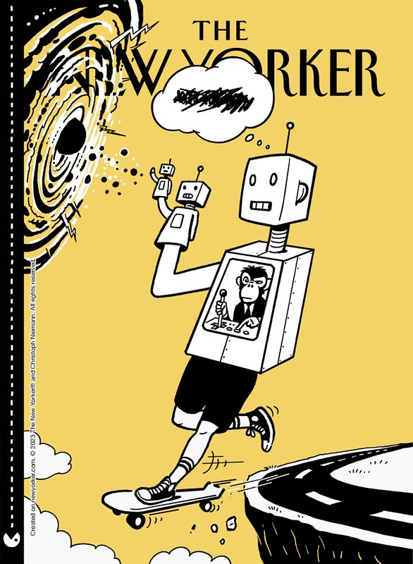
Design a New Yorker Mag Cover: AI Issue is is CC BY-SA 2.0
A fake title page for the New Yorker with a robot with human legs and a monkey operating it from inside is skating off a ledge on a skateboard. On the robot's hand is robot, and on that robot's hand is another robot, which appears to be peering into space or a black hole. The main robot is thinking something, but the words are redacted or scratched out.
This image was designed by a tool available through The New Yorker

Slide 6
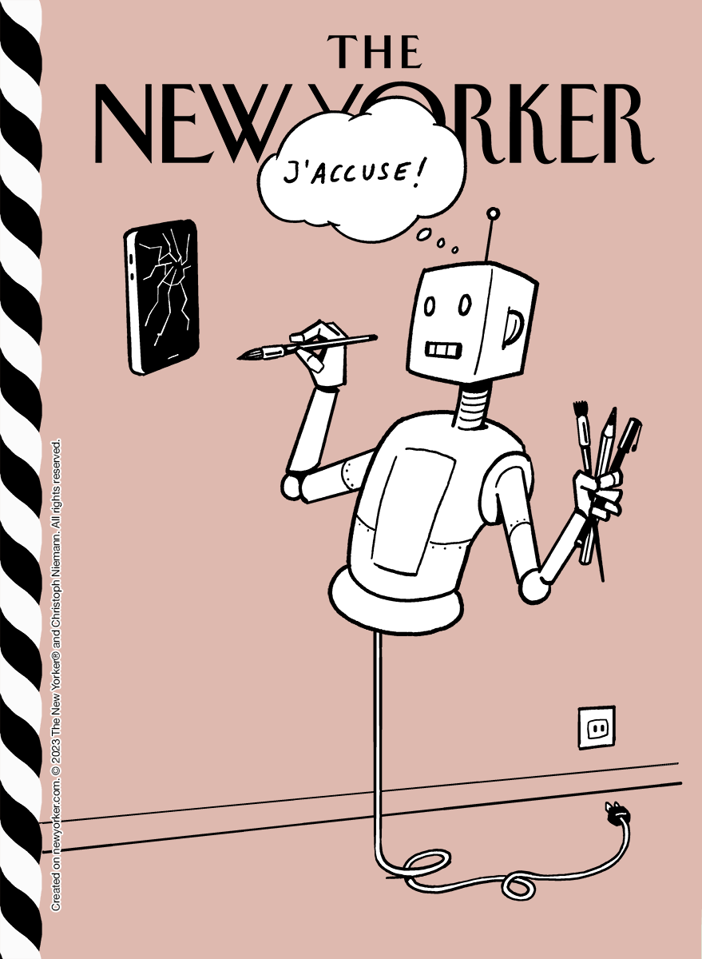
Create Your Own Cover with Till-E by Ean Paulson is CC0.
A robot with a robot head and body that is not plugged into the wall is holding writing and drawing utensils in one hand, and with the other arm pointing a paintbrush at a broken cell. The robot is thinking, "J'accuse," which means "I accuse" in English. The expression symbolized a powerful denunciation or accusation against someone or something.
This image was designed by a tool available through The New Yorker

Slide 7
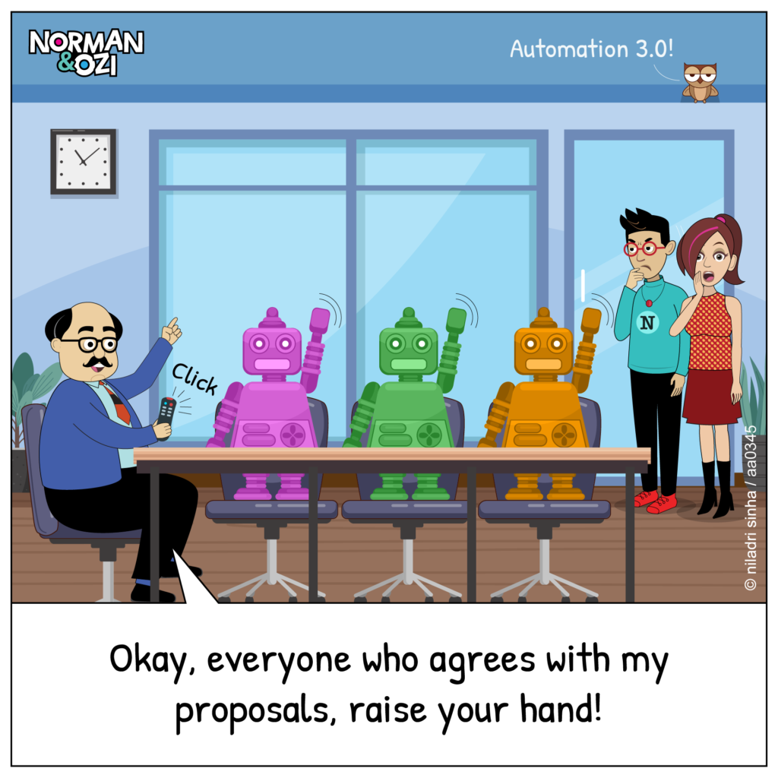
When AI is the only thing that agrees with the Boss, he only considers them
Cartoon by Norman & Ozi, www.normanandozi.com. Used with permission. Visit www.normanandozi.com for more office humor cartoons.
A white middle-aged male with glasses and a mustache is at the head of a conference table, pressing a remote control. The boss says with one arm raised, "Okay, everyone who agrees with my proposal, raise your hand!"
Three robots sitting at the conference table, which are exactly the same except for different colours, raise one arm each together in assent.
Two humans, a white female and an Asian male with glasses, stand behind at the door of the conference room with hands at their face in worry and frustration.

Slide 8
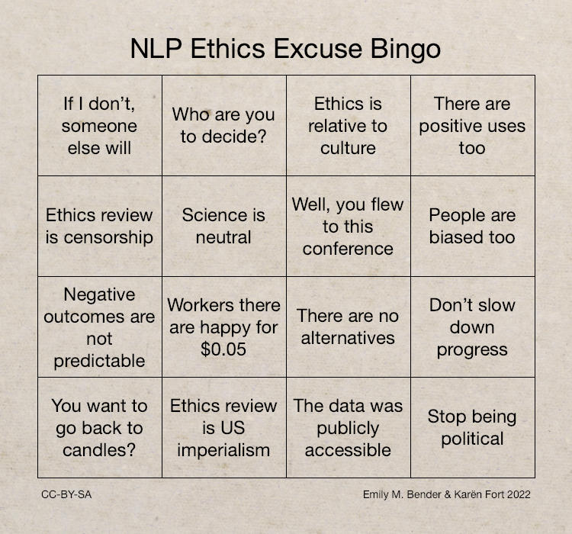
NLP Excuse Bingo by Emily M Bender and Karen fort (2022) is CC BY-SA
The image is set up like a bingo card. The title is NLP (Natural Language Processing) Excuse Bingo. The items to be crossed off are:
If I don't, someone else will
Who are you to decide
Ethics is relative to culture
There are positive uses too
Ethics review is censorship
Science is neutral
Well, you flew to this conference
People are biased too
Negative outcomes are not predictable
Workers there are happy for $0.05
There are no alternatives
Don't slow down progress
You want to go back to candles
Ethics review is US imperialism
The data was publicly accessible
Stop being political

Slide 9
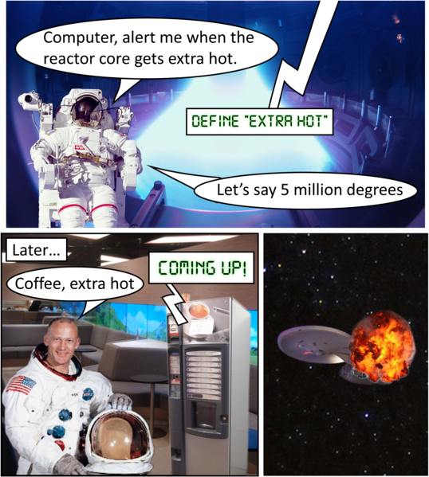
ikael Häggström, M.D. Author info - Reusing images- using source images by various creators (see above), CC BY 4.0, via Wikimedia Commons
The image is a three-panel comic strip. In the first panel an astronaut in his suit and helmet says, "Computer, alert me when the reactor core gets extra hot." A computer voice says, "Define extra hot." The astronaut replies, "Let's say 5 millon degrees."
In the second panel, titled "Later...," the white male astronaut inside the spaceship with his helmet off says, "Coffee, extra hot." The computer, which is a coffee vending machine, says, "Coming up!"
In the third panel, a picture of a ship in space is exploding.

Slide 10
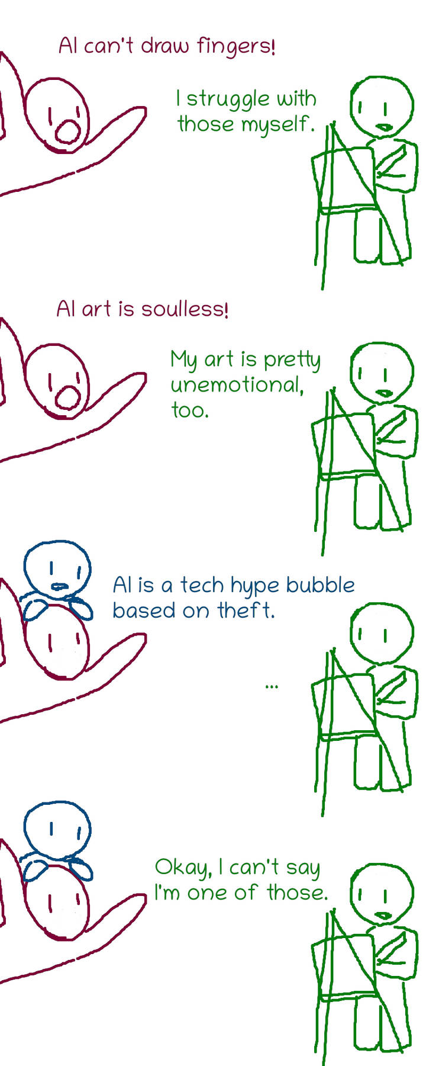
On AI by diamonddmgirl is licensed CC BY 3.0
In the first panel, a red character with its hands up says, "AI can't draw fingers." A green artist character next to an easel and with a drawing instrument in its hand says, "I struggle with those myself."
In the second panel, the red character says, "AI is soulless!" The green character replies, "My art is pretty unemotional too."
In the third panel, a smaller blue character appears on top of the red character and says, "AI is a tech hype bubble based on theft."
In the fourth panel, the green character says, "Okay, I can't say I'm one of those."

